Slide 1
Modeling Impact of SAVs on
VMT in Utah
Jason Chen, RSG
Robert Chamberlin, RSG
Kiavash Fayyaz, RSG
Nima Haghighi, The University of Utah
Cathy Liu, The University of Utah
Kevin Nichol, Utah Department of Transportation
June 2019

Slide 2

Key Question
How will shared/connected/autonomous vehicles
affect VMT in Utah?
Notes:
Aiming to simplify the research by focusing on VMT.
Key item – AVs, and Connected vehicles, and Mobility as a Service (or shared vehicles) are intertwined.

Slide 3
How We Will Address the Question
Wasatch Front Travel Model
Experimental Design
Demand Side Effects of AVs

Slide 4
When It Comes To VMT, Where SAVs Fit In
Trip Generation
Mode Choice
Destination Choice
Notes:
One model of a Shared AV world in urban setting is that the transit operator owns the SAVs, and sends the appropriate sized vehicle in response to realtime trip reservation demand, using algorithms (like Uber Pool and Lyftline use now) to most efficiently combine and chain trips. In this view, SAV is transit. To the extent that the populace is willing to use SAV (which as Jon points out is partially dependent on pricing), ZOV trips may be less of an issue and VMT growth manageable.

Slide 5
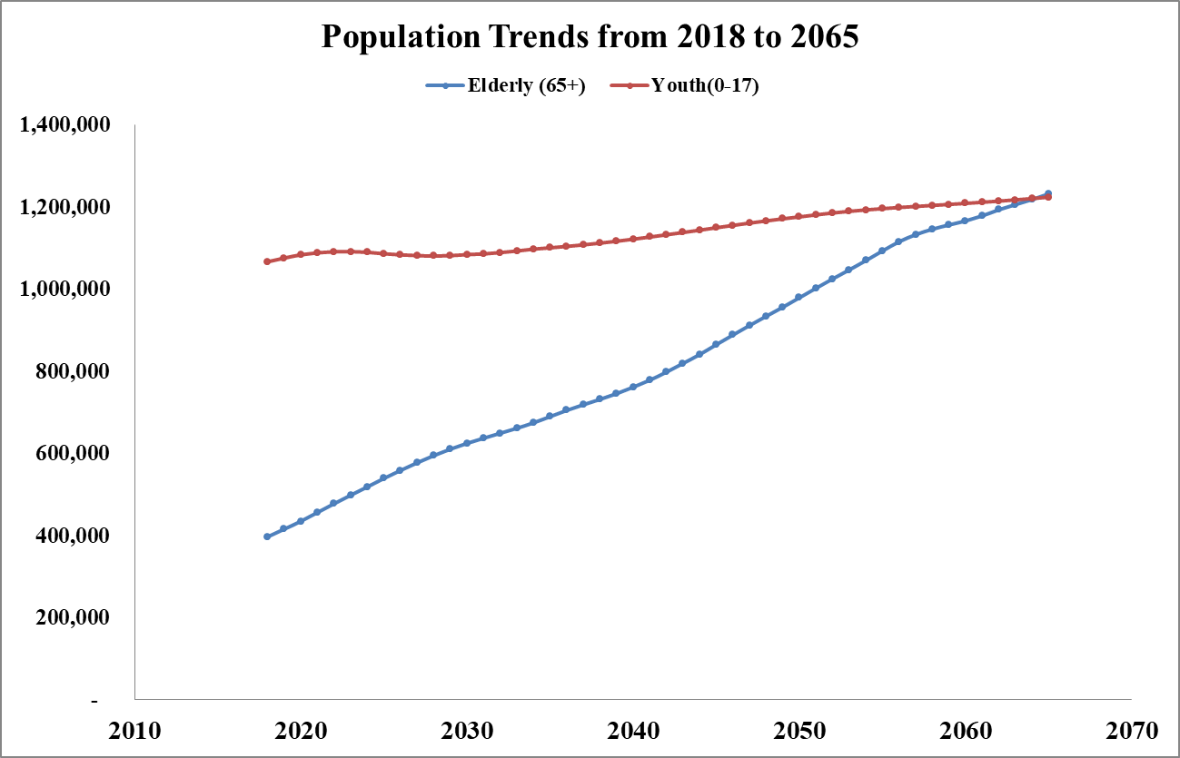
Trip Generation
Latent demand from specific demographics:
  Non-driving adults (>=19-64 yrs)
  Elderly
  Disabled (travel-restrictive
  medical condition)
  Youth

Slide 6
Trip Generation
Increased the trip rates
  Weighted based on Census data for non-driving, elderly, disabled, youth population %
  Only non-work purposes
  Three design scenarios

Slide 7
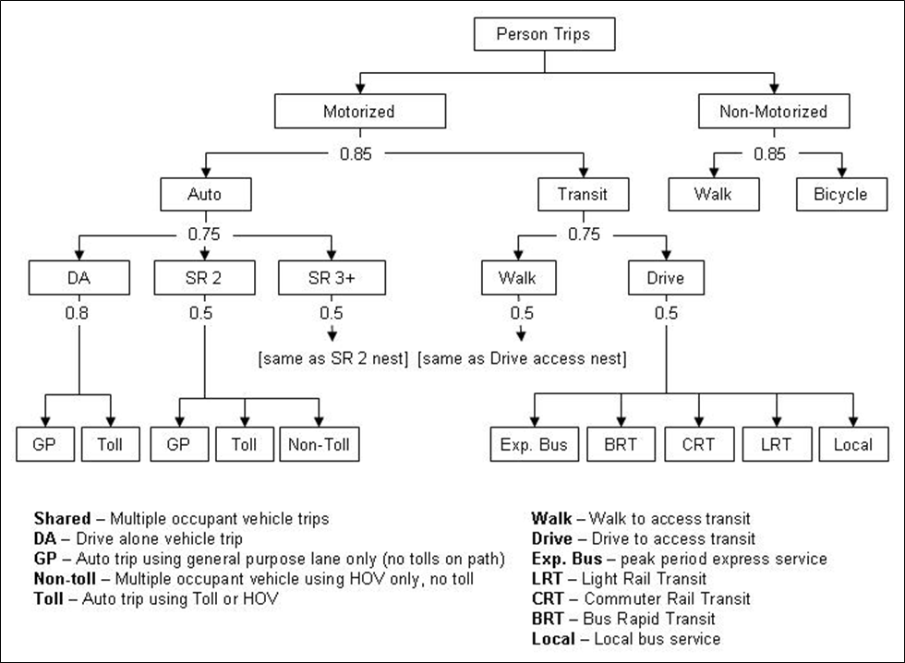
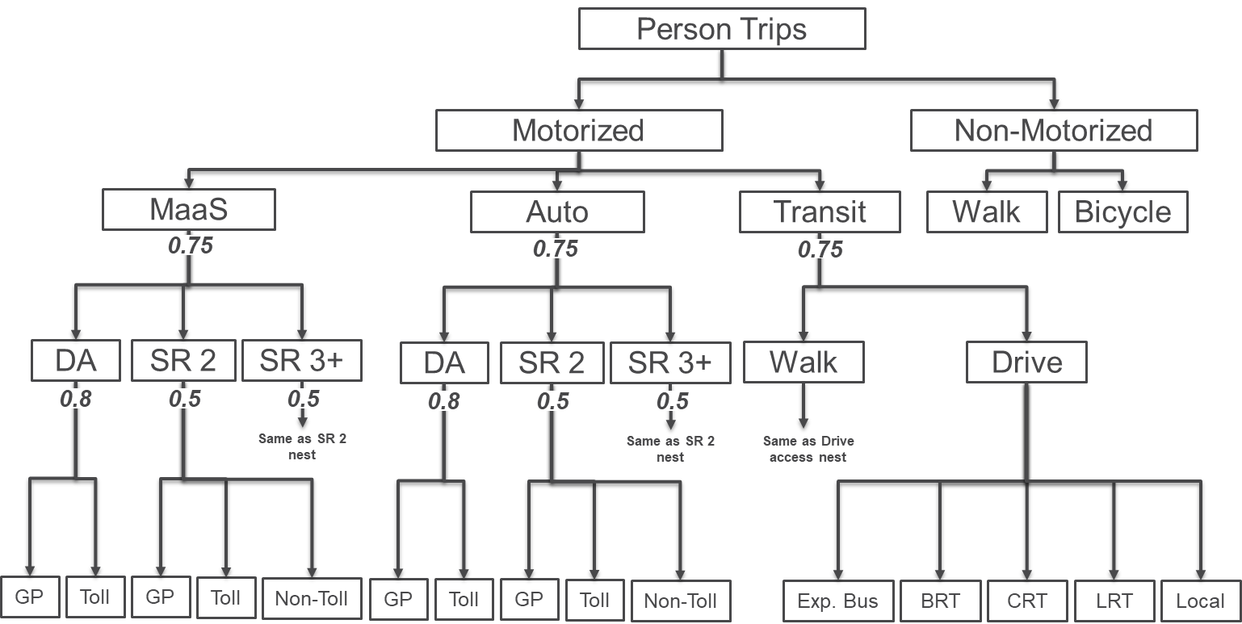
Mode Choice Adjustment

Slide 8
Mode Choice Adjustment
Discount on vehicle value of time for in-vehicle time disutility
Trip Purpose | In-Vehicle Time Coefficients
 | Base | Low | Mid | High
HBW | -0.045 | -0.0405 | -0.036 | -0.0315
HBO | -0.035 | -0.0315 | -0.028 | -0.0245
NHB | -0.04 | -0.036 | -0.032 | -0.028
HBC | -0.025 | -0.0225 | -0.02 | -0.0175

Slide 9
Mode Choice Adjustment
Operating cost based on current Uber and Lyft fares
Cost Type | Operating Cost for Scenario
 | Low/Base | Mid | High
Distance-Based Cost ($/mile) | 0.679 | 0.611 | 0.543
Initial Fee ($) | 2.590 | 2.331 | 2.072
Time-Based Cost ($/min) | 0.174 | 0.157 | 0.139

Slide 10
Mode Choice Adjustment
Initial pick-up time (minutes)
Area Type | Scenario
 | Low/Base | Mid | High
CBD Core | 3 | 3 | 3
CBD | 5 | 5 | 5
Urban | 8 | 7.2 | 6.4
Urban-Rural | 12 | 10.8 | 9.6
Rural | 15 | 13.5 | 12

Slide 11
VMT Estimation
Additional VMT for repositioning trips for peak and off-peak period

Slide 12
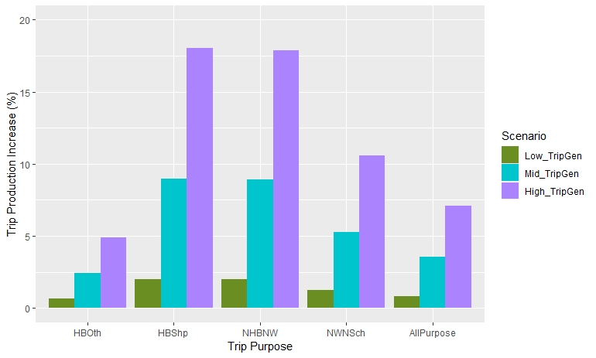
Key Findings: Trip Generations
Underserved population making more trips…

Slide 13
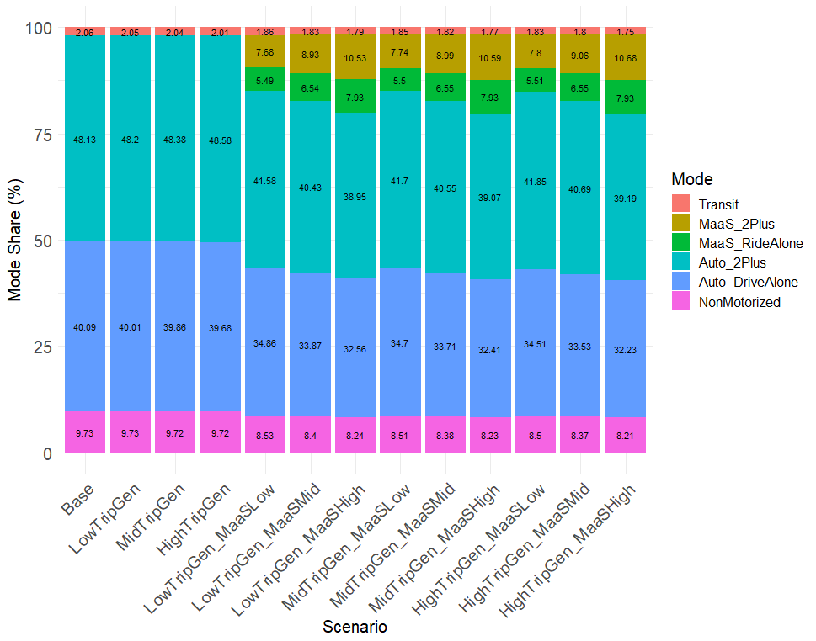
Key Findings: Mode Shift
Auto mode more likely to shift
Shared ride modes more likely to shift
MaaS Share more attractive than MaaS alone

Slide 14
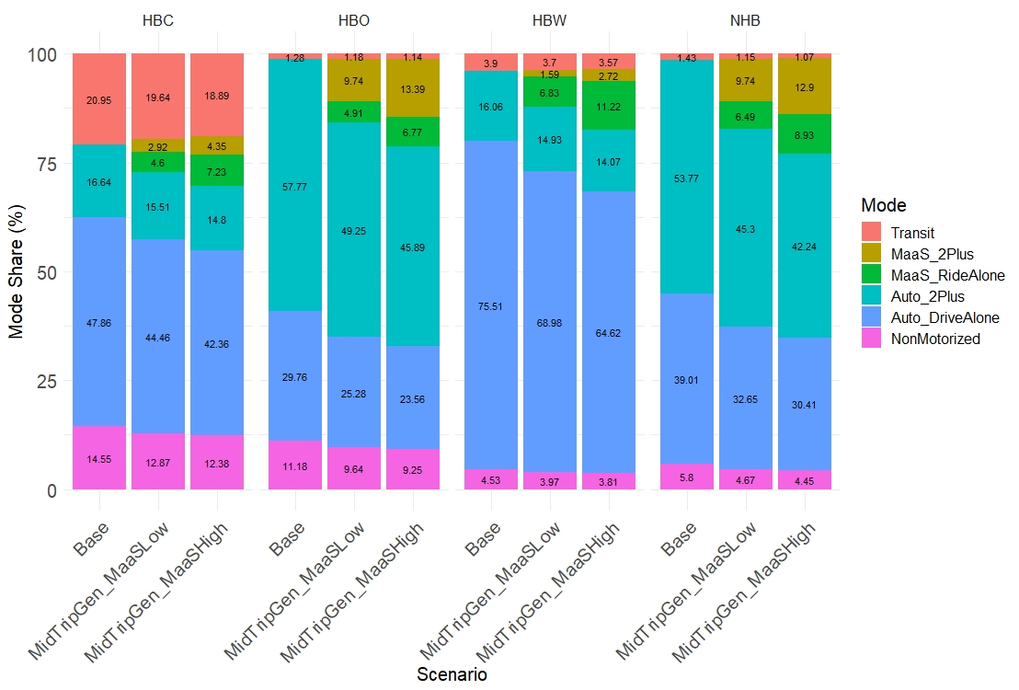
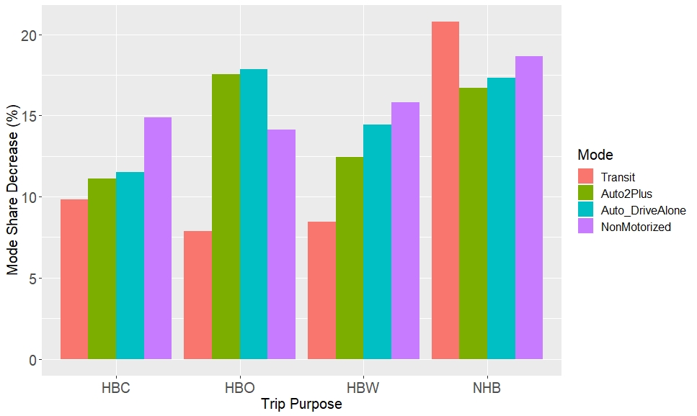
Key Findings: Mode Shift
Shifting to MaaS more likely in HBO and NHB
Transit has largest market share shift to MaaS in NHB
MaaS share in HBO and NHB
% Decrease from Transit mode

Slide 15
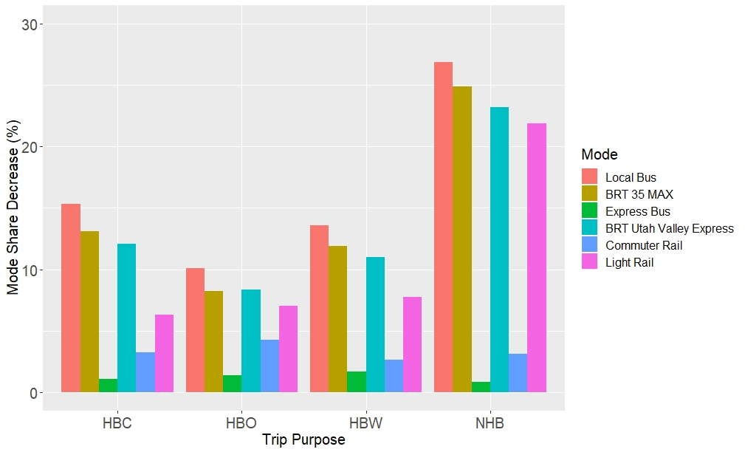
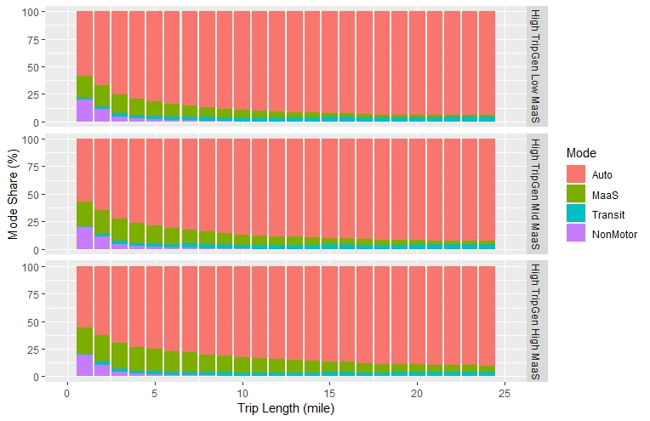
Key Findings: Mode Shift
MaaS competes most effectively with local bus among available transit modes
MaaS is more desirable for shorter trips

Slide 16
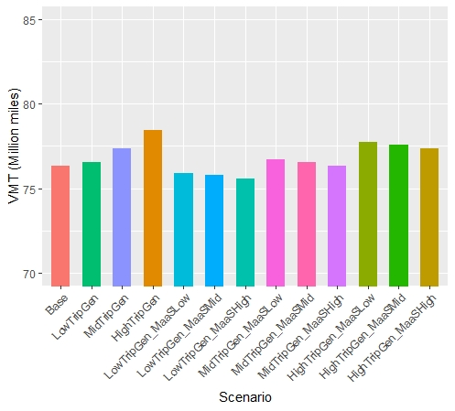
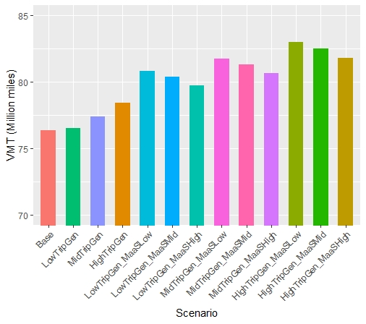
VMT Changes
No Repositioning
With Repositioning

Slide 17
Summary
Total trips increase by 1% to 7%
MaaS competes more with auto and non-motorized, except for NHB trips
MaaS competes most effectively with local bus among available transit modes
MaaS shared is more attractive than MaaS alone
VMT increased by 4% to 9%

Slide 18
Challenges
Results are “What if”
Repositioning trips impact on roadway capacity and
auto ownership
Security and safety concerns not considered in SAV

Slide 19
Robert Chamberlin
Senior Director
Bob.Chamberlin@rsginc.com
801-744-3902
Jason Chen
Consultant
Jason.Chen@rsginc.com
802-295-4999

